Slide 1
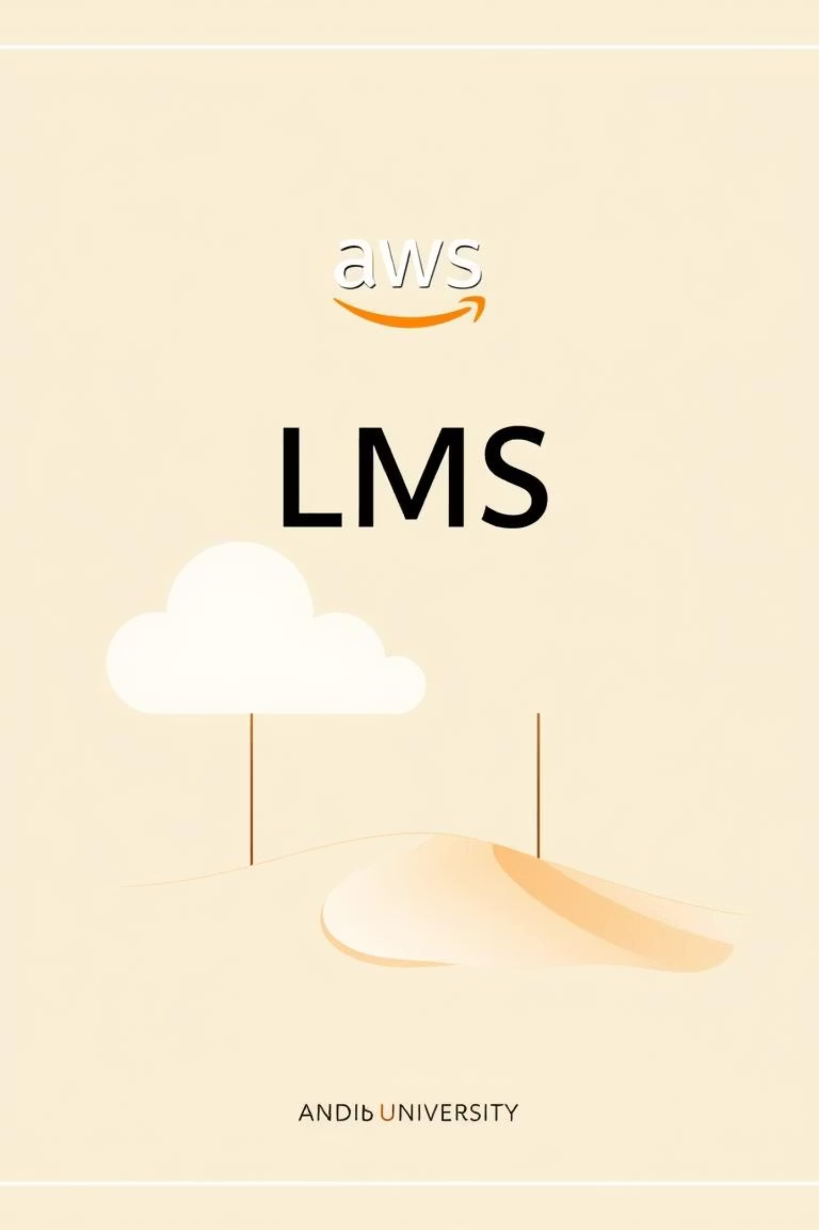
Cloud-Based Learning Management System (LMS) Using AWS
Authors: Ibrahim Sattar, Abdullah Amjad Cheema — Department of Software Engineering (ITU)
Semester Project: Software Construction & Development (SDC) — IEEE Student Symposium

Slide 2
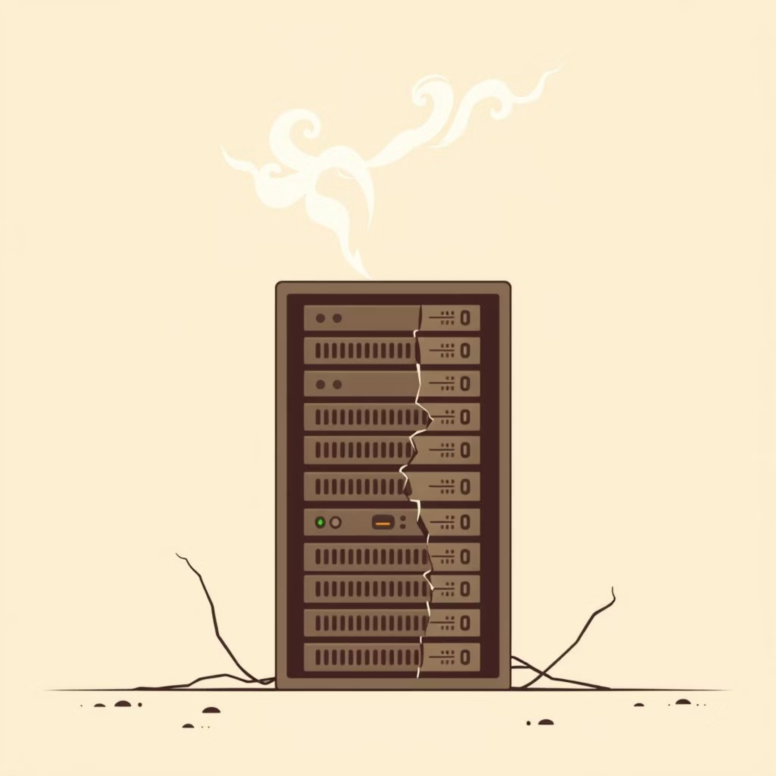

Problem & Motivation
Traditional LMS Challenges
Our Solution: Resilient & Scalable
Limited availability
Predictable uptime
Single-server failures
Quick content delivery
Poor performance under peak load
Seamless scaling for term peaks

Slide 3
Key Objectives
1
2
Scalable Architecture
Frappe Deployment
Design a highly available LMS architecture.
Deploy Frappe-based LMS on EC2 behind an ALB.
3
4
Auto Scaling Group
Managed Database
Implement ASG for web tier elasticity.
Use Amazon RDS (MySQL) for relational storage.
5
6
Secure Credentials
Static Content
Protect credentials with AWS Secrets Manager.
Host static content in S3 + CloudFront.

Slide 4
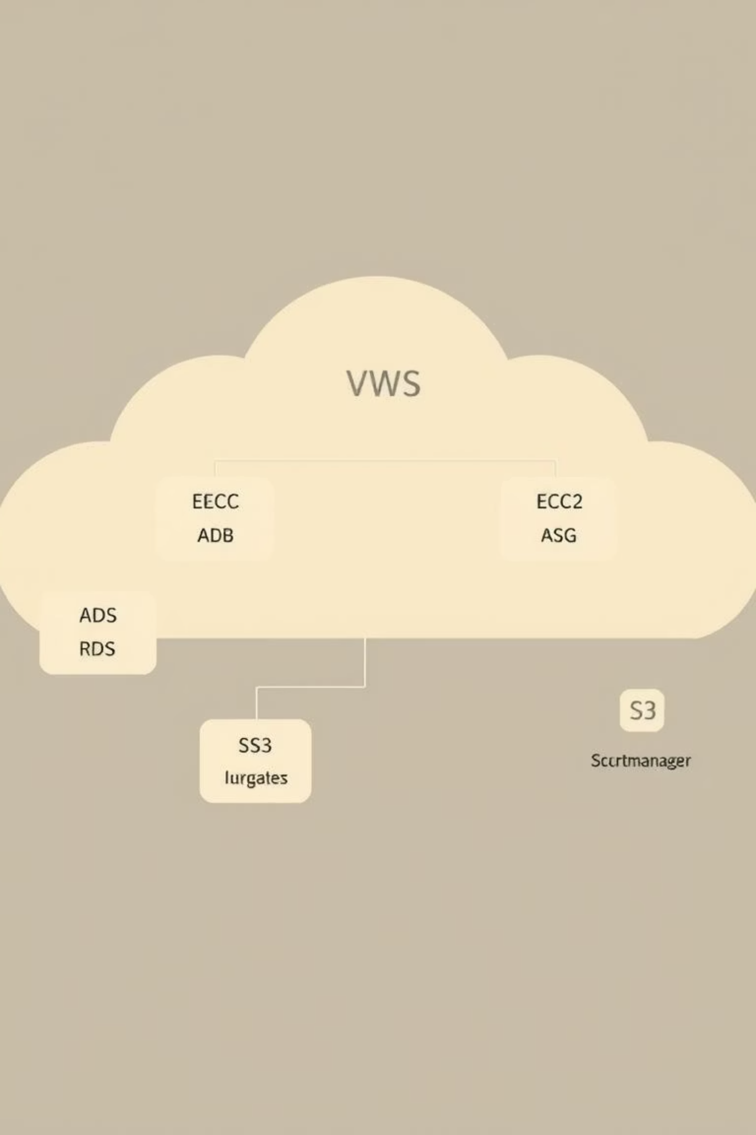
High-Level Architecture
Our architecture utilizes a Multi-AZ VPC, with EC2 instances in an ASG behind an ALB for the web tier. Data is stored in Amazon RDS (MySQL), and static assets are served via S3 + CloudFront. AWS Secrets Manager secures database credentials.

Slide 5


Component Breakdown: Web & App
EC2 (Frappe App)
Auto Scaling Group
Dockerized Frappe app or direct Python/Frappe install on AMI; launch template for ASG.
Scales based on CPU or request metrics; uses lifecycle hooks for graceful start/stop.
Application Load Balancer
Provides health checks, optional sticky sessions, and TLS termination.

Slide 6
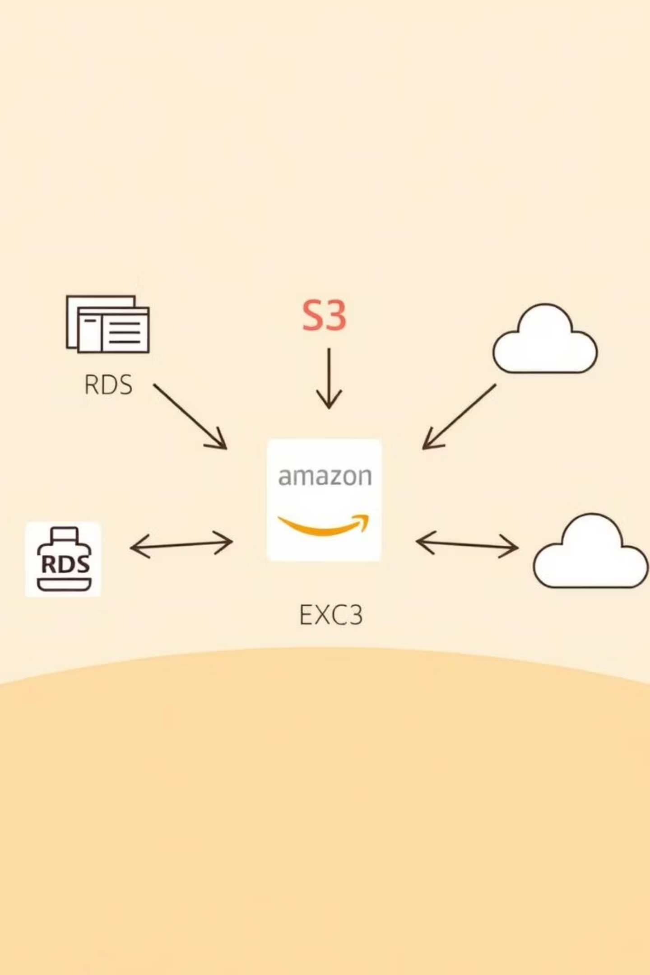
Component Breakdown: Data & Storage
Amazon RDS (MySQL)
Multi-AZ for failover; automated snapshots for backups.
AWS Secrets Manager
Stores and rotates DB credentials; EC2 retrieves secrets via IAM role.
Amazon S3 + CloudFront
Stores course materials, media, and backups; CloudFront provides CDN caching and HTTPS.

Slide 7
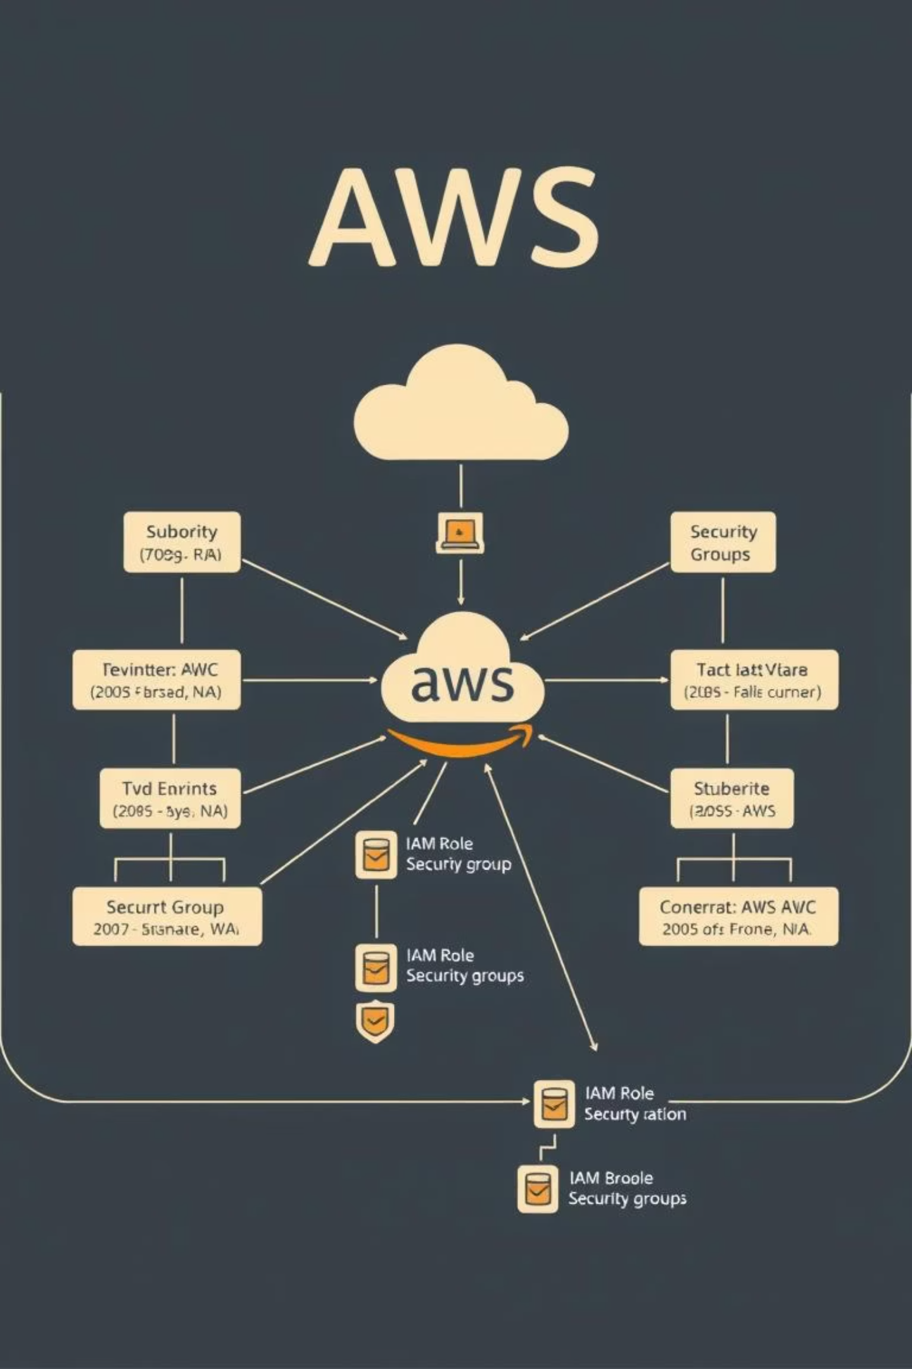
Security, IAM & Networking
VPC Configuration
Public/private subnets, route tables, and security groups with least privilege.
IAM Instance Profile
Grants read access to Secrets Manager and S3, eliminating long-lived credentials.
TLS & Access Control
TLS via ALB/CloudFront; security groups restrict RDS access to private subnets.
Encryption
RDS and S3 encryption at rest; optional WAF for ALB protection.

Slide 8
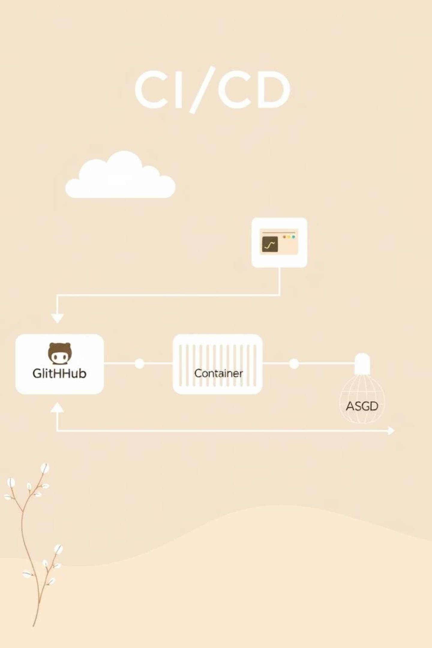




Deployment, CI/CD & Operations
Source Control
GitHub for code management.
CI/CD
Automated build, test, push image, and ASG updates via GitHub Actions.
Monitoring & Logging
CloudWatch for metrics and alarms; centralized logs (CloudWatch Logs / ELK).
Backup & Recovery
RDS automated snapshots; S3 versioning; AMI backups.

Slide 9

Performance, Scalability & Observations
Horizontal scaling at web layer via ASG (CPU, request count).
CDN + S3 offloads static assets, reducing EC2 and DB load.
Redis caching reduces DB queries for session and background jobs.
Expected improvements in availability and response time.
RDS remains primary vertical bottleneck; read replicas for future.
Load tests would further validate peak requests/sec and response time improvements.

Slide 10


Conclusion & Roadmap
What We Delivered
Next Steps
Improved availability, scalability, and security for LMS deployments.
Add RDS read-replicas
Database tuning
Terraform IaC
Blue/Green deployments
Autoscaling DB (Aurora)
Cost optimization

